Slide 1
Azure Databricks An introduction

Slide 2
The modern data estate
LOB
CRM
Graph
Image
Social
IoT
Hybrid
Operational databases
Operational databases
Data warehouses
Data warehouses
Data Lakes
Data Lakes
Reason over any data, anywhere
Flexibility of choice
Security and performance
Notes:
All kinds of data being generated
Stored on-premises and in the cloud – but vast majority in hybrid
Reason over all this data without requiring to move data
They want a choice of platform and languages, privacy and security
<Transition> Microsoft’s offerng

Slide 3
The MICROSOFT offering
LOB
CRM
Graph
Image
Social
IoT
SQL Server
Hybrid
Azure Data Services
Easiest lift and shift with no code changes
Industry leader 2 years in a row
Operational databases
Operational databases
70% faster than Aurora
#1 TPC-H performance
Data warehouses
Data warehouses
2x global reach than Redshift
T-SQL query over any data
Data lakes
Data lakes
No Limits Analytics with 99.9% SLA
AI built-in | Most secure | Lowest TCO
Reason over any data, anywhere
Flexibility of choice
Security and performance
Notes:
The most complete and compelling offering
SQL Server, Azure Database Services (+ Open Source), Hybrid
AI Built in, Most Secure, Lowest TCO – 1/10th cost of Oracle
<Transition> DEMO

Slide 4
Big Data & Advanced Analytics in Azure

Slide 5

Big Data & Advanced Analytics at a glance
Ingest
Store
Prep & Train
Model & Serve
Intelligence
Business apps
Data Factory
(Data movement, pipelines & orchestration)
Cosmos DB
Predictive apps
Blobs
Data Lake
Databricks
HDInsight
Data Lake Analytics
SQL
Custom apps
Kafka
10 01
SQL Database
SQL Data Warehouse
Operational reports
Event Hub
IoT Hub
Machine Learning
Sensors and devices
Analysis Services
Analytical dashboards
Notes:
Azure build-out of DMSA. Supports hybrid\on-premises too through ADF \ Blob \ Stretch.

Slide 6
Azure Databricks Powered by Apache Spark

Slide 7

Why Spark?
Open-source data processing engine built around speed, ease of use, and sophisticated analytics
In memory engine that is up to 100 times faster than Hadoop
Largest open-source data project with 1000+ contributors
Highly extensible with support for Scala, Java and Python alongside Spark SQL, GraphX, Streaming and Machine Learning Library (Mllib)
Notes:
When it comes to ease of use, Spark again happens to be a lot better than Hadoop. Spark has APIs for several languages such as Scala, Java and Python, besides having the likes of Spark SQL. It is relatively simple to write user-defined functions. It also happens to boast an interactive mode for running commands. Hadoop, on the other hand, is written in Java and has earned the reputation of being pretty difficult to program, although it does have tools that assist in the process. (To learn more about Spark, see How Apache Spark Helps Rapid Application Development.)
In-Memory Technology
One of the unique aspects of Apache Spark is its unique "in-memory" technology that allows it to be an extremely good data processing system. In this technology, Spark loads all of the data to the internal memory of the system and then unloads it on the disk later. This way, a user can save a part of the processed data on the internal memory and leave the remaining on the disk.
Spark also has an innate ability to load necessary information to its core with the help of its machine learningalgorithms. This allows it to be extremely fast.
Spark’s Core
Spark’s core manages several important functions like setting tasks and interactions as well as producing input/output operations. It can be said to be an RDD, or resilient distributed dataset. Basically, this happens to be a mix of data that is spread across several machines connected via a network. The transformation of this data is created by a four-step method, comprised of mapping the data, sorting it, reducing it and then finally, joining the data.
Following this step is the release of the RDD, which is done with support from an API. This API is a union of three languages: Scala, Java and Python.
Spark’s SQL
Apache Spark’s SQL has a relatively new data management solution called SchemaRDD. This allows the arrangement of data into many levels and can also query data via a specific language.
Graphx Service
Apache Spark comes with the ability to process graphs or even information that is graphical in nature, thus enabling the easy analysis with a lot of precision.
Streaming
This is a prime part of Spark that allows it to stream large chunks of data with help from the core. It does so by breaking the large data into smaller packets and then transforming them, thereby accelerating the creation of the RDD.
MLib – Machine Learning Library
Apache Spark has the MLib, which is a framework meant for structured machine learning. It is also predominantly faster in implementation than Hadoop. MLib is also capable of solving several problems, such as statistical reading, data sampling and premise testing, to name a few.

Slide 8
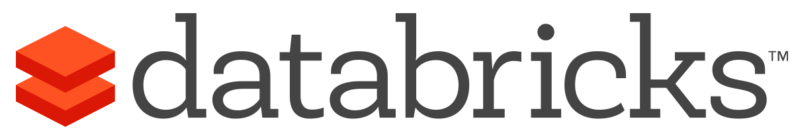


What is Azure Databricks?
A fast, easy and collaborative Apache® Spark™ based analytics platform optimized for Azure
Best of Databricks
Best of Microsoft
Designed in collaboration with the founders of Apache Spark
One-click set up; streamlined workflows
Interactive workspace that enables collaboration between data scientists, data engineers, and business analysts.
Native integration with Azure services (Power BI, SQL DW, Cosmos DB, Blob Storage)
Enterprise-grade Azure security (Active Directory integration, compliance, enterprise-grade SLAs)
Notes:
Azure Databricks features –
Enhance your teams’ productivity
Get started quickly by launching your new Spark environment with one click.
Share your insights in powerful ways through rich integration with PowerBI.
Improve collaboration amongst your analytics team through a unified workspace.
Innovate faster with native integration with rest of Azure platform.
Build on the most compliant and trusted cloud
Simplify security and identity control with built-in integration with Active Directory.
Regulate access with fine-grained user permissions to Azure Databricks’ notebooks, clusters, jobs and data.
Build with confidence on the trusted cloud backed by unmatched support, compliance and SLAs.
Scale without limits
Operate at massive scale without limits globally.
Accelerate data processing with the fastest Spark engine.

Slide 9
Differentiated experience on Azure
ENHANCE PRODUCTIVITY
BUILD ON THE MOST COMPLIANT CLOUD
SCALE WITHOUT LIMITS
Get started quickly by launching your new Spark environment with one click.
Share your insights in powerful ways through rich integration with Power BI.
Improve collaboration amongst your analytics team through a unified workspace.
Innovate faster with native integration with rest of Azure platform
Simplify security and identity control with built-in integration with Active Directory. Regulate access with fine-grained user permissions to Azure Databricks’ notebooks, clusters, jobs and data.
Build with confidence on the trusted cloud backed by unmatched support, compliance and SLAs.
Operate at massive scale without limits globally.
Accelerate data processing with the fastest Spark engine.
Notes:
Databricks, founded by the team that created Apache Spark – unified analytics platform that accelerates innovation by unifying data science, engineering & business.
75% of the code committed to Apache Spark comes from Databricks
Unified Runtime
Create clusters in seconds, dynamically scale them up and down.
They’ve made enhancements to Spark engine to make it 10x faster than open source Spark
Serverless- Auto-configured multi-user cluster, Reliable sharing with fault isolation
Unified Collaboration
Overall – a simple & collaborative environment that enables your entire team to use Spark & interact with your data simultaneously
DE – Improve ETL performance, zero management clusters. Execute production code from within notebooks
DS - For data scientists, easy data exploration in notebooks
Business SME – interactive dashboards empower teams to create dynamic reports
Enterprise Security
Encryption
Fine grained Role-based access control (files, clusters, code, application, dashboard)
Compliance
Rest APIs
DE – DBIO, SPARK, API’s , JOBS
DS – Spark and Serverless, Interactive Data Science
Data Products - Everything
Creators of Spark
Training People
Number of Customers
Ingest
Workflow
Schedule / Run / Monitor
Execute
Troubleshoot
Debug
Production Jobs
---------
Ingest, ETL, Scheduling, Monitoring

Slide 10



Azure Databricks key audiences & benefits
Data scientist
Data engineer
CDO, VP of analytics
Integrated workspace
Easy data exploration
Collaborative experience
Interactive dashboards
Faster insights
Best Spark & serverless
Databricks managed Spark
Improved ETL performance
Zero management clusters, serverless
Easy to schedule jobs
Automated workflows
Enhanced monitoring & troubleshooting
Automated alerts & easy access to logs
Zero Management Spark
Cluster democratization (serverless)
Fast, collaborative analytics platform accelerating time to market
No dev-ops required
Enterprise grade security
Encryption
End-to-end auditing
Role-based control
Compliance
Unified analytics platform
Provided by Microsoft and Databricks under NDA

Slide 11

Azure Databricks
Azure Databricks
Collaborative Workspace
IoT / streaming data
Machine learning models
DATA ENGINEER
DATA SCIENTIST
BUSINESS ANALYST
Deploy Production Jobs & Workflows
Cloud storage
BI tools
MULTI-STAGE PIPELINES
JOB SCHEDULER
NOTIFICATION & LOGS
Data warehouses
Optimized Databricks Runtime Engine
Data exports
Hadoop storage
DATABRICKS I/O
APACHE SPARK
SERVERLESS
Rest APIs
Data warehouses
Enhance Productivity
Build on secure & trusted cloud
Scale without limits
Notes:
Databricks, founded by the team that created Apache Spark – unified analytics platform that accelerates innovation by unifying data science, engineering & business.
75% of the code committed to Apache Spark comes from Databricks
Unified Runtime
Create clusters in seconds, dynamically scale them up and down.
They’ve made enhancements to Spark engine to make it 10x faster than open source Spark
Serverless- Auto-configured multi-user cluster, Reliable sharing with fault isolation
Unified Collaboration
Overall – a simple & collaborative environment that enables your entire team to use Spark & interact with your data simultaneously
DE – Improve ETL performance, zero management clusters. Execute production code from within notebooks
DS - For data scientists, easy data exploration in notebooks
Business SME – interactive dashboards empower teams to create dynamic reports
Enterprise Security
Encryption
Fine grained Role-based access control (files, clusters, code, application, dashboard)
Compliance
Rest APIs
DE – DBIO, SPARK, API’s , JOBS
DS – Spark and Serverless, Interactive Data Science
Data Products - Everything
Creators of Spark
Training People
Number of Customers
Ingest
Workflow
Schedule / Run / Monitor
Execute
Troubleshoot
Debug
Production Jobs
---------
Ingest, ETL, Scheduling, Monitoring

Slide 12
Collaborative Workspace
GET STARTED IN SECONDS
Single click to launch your new Spark environment
INTERACTIVE EXPLORATION
Explore data using interactive notebooks with support for multiple programming languages including R, Python, Scala, and SQL
COLLABORATION
Work on the same notebook in real-time while tracking changes with detailed revision history, GitHub, or Bitbucket
VISUALIZATIONS
Visualize insights through a wide assortment of point-and-click visualizations. Or use powerful scriptable options like matplotlib, ggplot, and D3
DASHBOARDS
Rich integration with PowerBI to discover and share your insights in powerful new ways
Azure Databricks
Collaborative Workspace
DATA ENGINEER
DATA SCIENTIST
BUSINESS ANALYST
Deploy Production Jobs & Workflows
MULTI-STAGE PIPELINES
JOB SCHEDULER
NOTIFICATION & LOGS
Optimized Databricks Runtime Engine
DATABRICKS I/O
APACHE SPARK
SERVERLESS
Rest APIs
Notes:
Databricks, founded by the team that created Apache Spark – unified analytics platform that accelerates innovation by unifying data science, engineering & business.
75% of the code committed to Apache Spark comes from Databricks
Unified Runtime
Create clusters in seconds, dynamically scale them up and down.
They’ve made enhancements to Spark engine to make it 10x faster than open source Spark
Serverless- Auto-configured multi-user cluster, Reliable sharing with fault isolation
Unified Collaboration
Overall – a simple & collaborative environment that enables your entire team to use Spark & interact with your data simultaneously
DE – Improve ETL performance, zero management clusters. Execute production code from within notebooks
DS - For data scientists, easy data exploration in notebooks
Business SME – interactive dashboards empower teams to create dynamic reports
Enterprise Security
Encryption
Fine grained Role-based access control (files, clusters, code, application, dashboard)
Compliance
Rest APIs
DE – DBIO, SPARK, API’s , JOBS
DS – Spark and Serverless, Interactive Data Science
Data Products - Everything
Creators of Spark
Training People
Number of Customers
Ingest
Workflow
Schedule / Run / Monitor
Execute
Troubleshoot
Debug
Production Jobs
---------
Ingest, ETL, Scheduling, Monitoring

Slide 13
Deploy Production Jobs & Workflows
JOBS SCHEDULER
Execute jobs for production pipelines on a specific schedule
NOTEBOOK WORKFLOWS
Create multi-stage pipelines with the control structures of the source programming language
RUN NOTEBOOKS AS JOBS
Turn notebooks or JARs into resilient Spark jobs with a click or an API call
NOTIFICATIONS AND LOGS
Set up alerts and quickly access audit logs for easy monitoring and troubleshooting
INTEGRATE NATIVELY WITH AZURE SERVICES
Deep integration with Azure SQL Data Warehouse, Cosmos DB, Azure Data Lake Store, Azure Blob Storage, and Azure Event Hub
Azure Databricks
Collaborative Workspace
DATA ENGINEER
DATA SCIENTIST
BUSINESS ANALYST
Deploy Production Jobs & Workflows
MULTI-STAGE PIPELINES
JOB SCHEDULER
NOTIFICATION & LOGS
Optimized Databricks Runtime Engine
DATABRICKS I/O
APACHE SPARK
SERVERLESS
Rest APIs
Notes:
Databricks, founded by the team that created Apache Spark – unified analytics platform that accelerates innovation by unifying data science, engineering & business.
75% of the code committed to Apache Spark comes from Databricks
Unified Runtime
Create clusters in seconds, dynamically scale them up and down.
They’ve made enhancements to Spark engine to make it 10x faster than open source Spark
Serverless- Auto-configured multi-user cluster, Reliable sharing with fault isolation
Unified Collaboration
Overall – a simple & collaborative environment that enables your entire team to use Spark & interact with your data simultaneously
DE – Improve ETL performance, zero management clusters. Execute production code from within notebooks
DS - For data scientists, easy data exploration in notebooks
Business SME – interactive dashboards empower teams to create dynamic reports
Enterprise Security
Encryption
Fine grained Role-based access control (files, clusters, code, application, dashboard)
Compliance
Rest APIs
DE – DBIO, SPARK, API’s , JOBS
DS – Spark and Serverless, Interactive Data Science
Data Products - Everything
Creators of Spark
Training People
Number of Customers
Ingest
Workflow
Schedule / Run / Monitor
Execute
Troubleshoot
Debug
Production Jobs
---------
Ingest, ETL, Scheduling, Monitoring

Slide 14
Optimized Databricks Runtime Engine
OPTIMIZED I/O PERFORMANCE
The Databricks I/O module (DBIO) takes processing speeds to the next level — significantly improving the performance of Spark in the cloud
FULLY-MANAGED PLATFORM ON AZURE
Reap the benefits of a fully managed service and remove the complexity of big data and machine learning
SERVERLESS INFRASTRUCTURE
Databricks’ serverless and highly elastic cloud service is designed to remove operational complexity while ensuring reliability and cost efficiency at scale
OPERATE AT MASSIVE SCALE
Without limits globally
SUPPORT FOR GPU ENABLED VMS
Specialized compute for your deep learning needs
Azure Databricks
Collaborative Workspace
DATA ENGINEER
DATA SCIENTIST
BUSINESS ANALYST
Deploy Production Jobs & Workflows
MULTI-STAGE PIPELINES
JOB SCHEDULER
NOTIFICATION & LOGS
Optimized Databricks Runtime Engine
DATABRICKS I/O
APACHE SPARK
SERVERLESS
Rest APIs
Notes:
Databricks, founded by the team that created Apache Spark – unified analytics platform that accelerates innovation by unifying data science, engineering & business.
75% of the code committed to Apache Spark comes from Databricks
Unified Runtime
Create clusters in seconds, dynamically scale them up and down.
They’ve made enhancements to Spark engine to make it 10x faster than open source Spark
Serverless- Auto-configured multi-user cluster, Reliable sharing with fault isolation
Unified Collaboration
Overall – a simple & collaborative environment that enables your entire team to use Spark & interact with your data simultaneously
DE – Improve ETL performance, zero management clusters. Execute production code from within notebooks
DS - For data scientists, easy data exploration in notebooks
Business SME – interactive dashboards empower teams to create dynamic reports
Enterprise Security
Encryption
Fine grained Role-based access control (files, clusters, code, application, dashboard)
Compliance
Rest APIs
DE – DBIO, SPARK, API’s , JOBS
DS – Spark and Serverless, Interactive Data Science
Data Products - Everything
Creators of Spark
Training People
Number of Customers
Ingest
Workflow
Schedule / Run / Monitor
Execute
Troubleshoot
Debug
Production Jobs
---------
Ingest, ETL, Scheduling, Monitoring

Slide 15
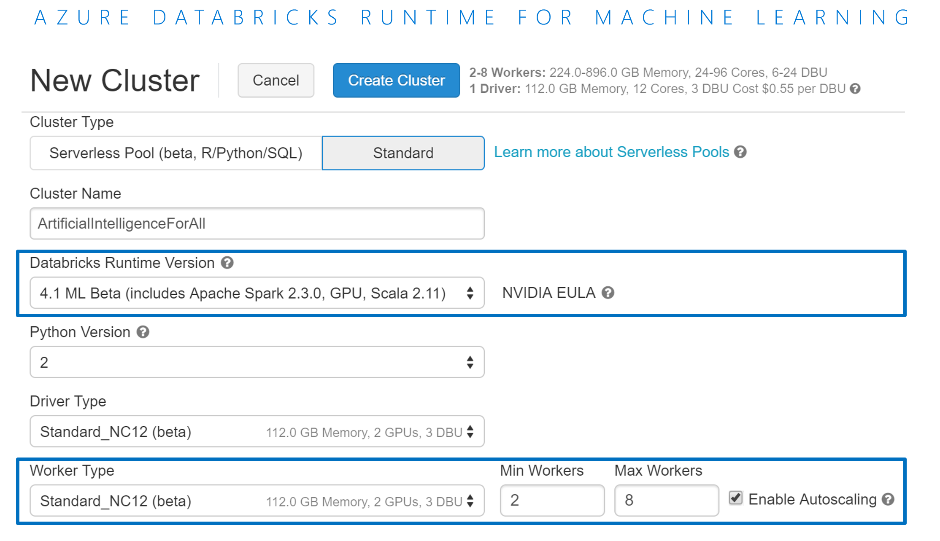
Azure Databricks Runtime for Machine Learning
Azure Databricks Runtime for Machine Learning
Pre-installed packages for machine learning like Tensorflow, Keras, Horovod and XGBoost
Pre-configured HorovodEstimator for seamless integration of Horovod with the Spark DataFrames
Support for GPU enabled VMs for specialized compute for your deep learning needs
Multi-GPU trainings of deep neural networks using Horovod
Unlock complex machine learning and deep learning scenarios with a few lines of code

Slide 16
Use Cases

Slide 17
Modern Big Data Warehouse
Ingest
Store
Prep & Train
Model & Serve
Intelligence
Logs, files and media (unstructured)
Data factory
Azure storage
Azure Databricks
(Spark)
Business / custom apps
(Structured)
Polybase
Data factory
Azure SQL Data Warehouse
Analytical dashboards

Slide 18
Advanced Analytics on Big Data
Ingest
Store
Prep & Train
Model & Serve
Intelligence
Logs, files and media (unstructured)
Data factory
Azure storage
Azure Databricks
(Spark Mllib, SparkR, SparklyR)
Azure Cosmos DB
Web & mobile apps
Business / custom apps
(Structured)
Polybase
Data factory
Azure SQL Data Warehouse
Analytical dashboards

Slide 19
Real-time analytics on Big Data
Ingest
Store
Prep & Train
Model & Serve
Intelligence
Unstructured data
Azure HDInsight (Kafka)
Azure Databricks
(Spark)
Polybase
Azure storage
Azure SQL Data Warehouse
Analytical dashboards

Slide 20
INDUSTRY USE CASES

Slide 21
FINANCIAL SERVICEs
Effective customer engagement
Decision services management
Risk and revenue management
Risk and compliance management
Recommendation engine
Customer profiles
Credit history
Transactional data
LTV
Loyalty
Customer segmentation
CRM data
Credit data
Market data
Transaction data
Demographics
Purchasing history
Trends
CRM
Credit
Risk
Merchant records
Products and services
Clickstream data
Products
Services
Customer service data
Customer analytics
Financial modeling
Risk, fraud, threat detection
Credit analytics
Marketing analytics
Customer 360 degree evaluation
Customer segmentation
Reduced customer churn
Underwriting, servicing and delinquency handling
Insights for new products
Commercial/retail banking, securities, trading and investment models
Decision science, simulations and forecasting
Investment recommendations
Real-time anomaly detection
Card monitoring and fraud detection
Security threat identification
Risk aggregation
Enterprise DataHub
Regulatory and compliance analysis
Credit risk management
Automated credit analytics
Recommendation engine
Predictive analytics and targeted advertising
Fast marketing and multi-channel engagement
Customer sentiment analysis
Faster innovation for a better customer experience
Improved consumer outcomes and increased revenue
Enhanced customer experience with machine learning
Transform growth with predictive analytics
Improved customer engagement with machine learning
Notes:
Benefit to customer
Data used
Databricks solution – title
One line takeaway

Slide 22


HEALTH & LIFE SCIENCES
DNA sequences
Real world analytics
Image deep learning
Sensor data
Social data listening
FAST-Q
BAM
SAM
VCF
Expression
HL7/CCD
837
Pharmacy
Registry
EMR
MRI
X-RAY
CT
Ultrasound
Readings
Time series
Event data
Social media
Adverse events
Unstructured
Genomics and precision medicine
Clinical and claims data
GPU image processing
IoT device analytics
Social analytics
Single cell sequencing
Biomarker, genetic, variant and population analytics
ADAM and HAIL on Databricks
Claims data warehouse
Readmission predictions
Efficacy and comparative analytics
Prescription adherence
Market access analysis
Graphic intensive workloads
Deep learning using Tensor Flow
Pattern recognition
Aggregation of streaming events
Predictive maintenance
Anomaly detection
Real-time patient feedback via topic modelling
Analytics across publication data
Faster innovation for drug development
Improved outcomes and increased revenue
Diagnostics leveraging machine learning
Predictive analytics transforms quality of care
Improved patient communications and feedback
Notes:
Benefit to customer
Data used
Databricks solution – title
One line takeaway

Slide 23
MEDIA & ENTERTAINMENT
Personalized recommendations
Effective customer retention
Information optimization
Inventory allocation
Consumer engagement analysis
Customer profiles
Viewing history
Online activity
Content sources
Channels
Customer profiles
Online activity
Content distribution
Services data
Consumption logs
Clickstream and devices
Marketing campaign responses
Transactions
Subscriptions
Demographics
Credit data
Content metadata
Ratings
Comments
Social media activity
Content personalization
Customer churn prevention
Recommendation engine
Predictive analytics
Sentiment analysis
Personalized viewing and engagement experience
Click-path optimization
Next best content analysis
Improved real time ad targeting
Quality of service and operational efficiency
Market basket analysis
Customer behavior analysis
Click-through analysis
Ad effectiveness
Content monetization
Fraud detection
Information-as-a-service
High value user engagement
Predict audience interests
Network performance and optimization
Pricing predictions
Nielsen ratings and projections
Mobile spatial analytics
Demand-elasticity
Social network analysis
Promotion events time-series analysis
Multi-channel marketing attribution
Faster innovation for customer experience
Improved consumer outcomes and increased revenue
Enhance user experience with machine learning
Predictive analytics transforms growth
Improved consumer engagement with machine learning
Notes:
Benefit to customer
Data used
Databricks solution – title
One line takeaway

Slide 24
RETAIL
Recommendation engine
Effective customer engagement
Inventory optimization
Inventory allocation
Consumer engagement
Customer profiles
Shopping history
Online activity
Social network analysis
Shopping history
Online activity
Floor plans
App data
Demand plans
Forecasts
Sales history
Trends
Local events/weather patterns
Demographics
Buyer perception
Consumer research
Market/competitive analysis
Historical sales data
Price scheduling
Segment level price changes
Next best and personalized offers
Store design and ergonomics
Data-driven stock, inventory, ordering
Assortment optimization
Real-time pricing optimization
Customer 360/consumer personalization
Right product, promotion, at right time
Multi-channel promotion
Path to purchase
In-store experience
Workforce and manpower optimization
Predict inventory positions and distribution
Fraud detection
Market basket analysis
Economic modelling
Optimization for foot traffic, Online interactions
Flat and declining categories
Demand-elasticity
Personal pricing schemes
Promotion events
Multi-channel engagement
Omni-channel shopping experience with machine learning
Faster innovation for customer experience
Predictive analytics transforms growth
Improved consumer outcomes and increased revenue
Improved consumer engagement with machine learning
Notes:
Benefit to customer
Data used
Databricks solution – title
One line takeaway

Slide 25
ADVERTISING AND MARKETING TECH
Effective customer engagement
Recommendation engine
Risk and fraud analysis
Campaign reporting analytics
Brand promotion and customer experience
Customer profiles
Online history
Transaction data
Loyalty
Customer segmentation
CRM data
Credit data
Market data
Transaction data
Demographics
Purchasing history
Trends
CRM
Merchant records
Products
Services
Marketing data
Social media
Online history
Customer service data
Customer value analytics
Next best and personalized offers
Risk and fraud management
Sales and campaign optimization
Sentiment analysis
Customer 360, segmentation aggregation and attribution
Audience modelling/index report
Reduce customer churn
Insights for new products
Historical bid opportunity as a service
Right product, promotion, at right time
Real time ad bidding platform
Personalized ad targeting
Ad performance reporting
Real-time anomaly detection
Fraud prevention
Customer spend and risk analysis
Data relationship maps
Optimizing return on ad spend and ad placement
Multi-channel promotion
Ideal customer traits
Optimized ad placement
Opinion mining/social media analysis
Deeper customer insights
Customer loyalty programs
Shopping cart analysis
Faster innovation for customer growth
Predictive analytics transforms growth
Improved outcomes and increased revenue
Risk management with machine learning
Improved customer engagement with machine learning
Notes:
Benefit to customer
Data used
Databricks solution – title
One line takeaway

Slide 26
OIL & GAS AND ENERGY
Upstream optimization, maximize well life
Grid operations, asset inventory optimization
Supply-chain optimization
Risk optimization
Recommendations engine
Field data
Asset data
Demographics
Production data
Sensor stream data
UAVs images
Inventory data
Production data
Transaction data
Demographics
Purchasing history
Trends
Sensor stream data
Transport
Retail data
Grid production data
Refinery tuning parameters
Clickstream data
Products
Services
Market data
Competitive data
Demographics
Digital oil field/ oil production
Industrial IoT
Supply-chain optimization
Safety and security
Sales and marketing analytics
Production optimization
Integrate exploration and seismic data
Minimize lease operating expenses
Decline curve analysis
Pipeline monitoring
Preventive maintenance
Smart grids and microgrids
Grid operations, Field Service
Asset performance as a Service
Trade monitoring, optimization
Retail mobile applications
Vendor management - construction, transportation, truck & delivery optimization
Real-time anomaly detection
Predictive analytics
Industrial safety
Environment health and safety
Fast marketing and multi-channel engagement
Develop new products and monitor acceptance of rates
Predictive energy trading
Deep customer insights
Faster innovation for revenue growth
Improved outcomes and increased revenue
Optimizing supply-chain with machine learning
Predictive analytics transforms safety and security
Improved customer engagement with machine learning
Notes:
Benefit to customer
Data used
Databricks solution – title
One line takeaway

Slide 27
SECURITY
Security controls to leverage all data
Actionable threat intelligence
Risk and fraud analysis
Compliance management
Identity and access management for analytics
Firewall/network logs
Apps
Data access layers
Firewall/network logs
Network flows
Authentications
Firewall/network logs
Web/app logs
Social media content
Firewall/network logs
Web
Applications
Devices
OS
Files
Tables
Clusters
Reports
Dashboards
Notebooks
Intrusion detection and predictive analytics
Security intelligence
Fraud detection and prevention
Security compliance reporting
Fine-grained data analytics security
Prevention of DDoS attacks
Threat classifications
Data loss/anomaly detection in streaming
Cybermetrics and changing use patterns
Real-time data correlation
Anomaly detection
Security context, enrichment
Offence scoring, prioritization
Security orchestration
e-Tailing
Inventory monitoring
Social media monitoring
Phishing scams
Piracy protection
Ad-hoc/historic incident reports
SOC/NOC dashboards
Deep OS auditing
Data loss detection in IoT
User behavior analytics
Role-based access controls
Auditing and governance
File integrity monitoring
Row level and column level access permissions
Transform security with improved visibility
Prevent complex threats with machine learning
Faster innovation for threat prevention
Risk management with machine learning
Limit malicious insiders to transform growth
Notes:
Benefit to customer
Data used
Databricks solution – title
One line takeaway

Slide 28
Business Model, Roadmap & Sales Guidance

Slide 29
Pricing during Public Preview & GA
Release | Standard | Premium
During public preview | Data analytics: $0.20/DBU/hr + VM Data engineering: $0.10/DBU/hr + VM Includes: AAD Integration; Data Connectors (Blob Storage, Data Lake, SQL DW, Cosmos DB), HDI Kafka | Data analytics: $0.275/DBU/hr + VM Data engineering: $0.175/DBU/hr + VM Includes: Everything from Standard + Fine grained control for notebooks & clusters, Structured Data Controls, JDBC/ODBC endpoint
Release | Standard | Premium | Community offer
General availability | Data analytics: $0.40/DBU/hr + VM Data engineering: $0.20/DBU/hr + VM Includes: Compliance: SOC2, HIPAA, AAD Integration Data connectors (Blob Storage, Data Lake, SQL DW, Cosmos DB, Event Hub), GPU Instances | Data analytics: $0.55/DBU/hr + VM Data engineering: $0.35/DBU/hr + VM Includes: Everything from standard + Fine grained control for notebooks & clusters, structured data controls JDBC/ODBC endpoint Governance logs .NET Integration Integrations with Azure apps like Power BI, etc. | Free + VM Limits: 1-node 6GB cluster 3 users / workspace Jobs feature disabled

Slide 30
Pricing
Launch Stage | Start Date | DBU Pricing | VM Pricing
Gated public preview | 11/15 | 50% | 100%
Ungated public preview | 1/23 | 50% | 100%
GA | ~3/15 | 100% | 100%

Slide 31
Roadmap
Add-ons to public preview
Deep integration with SQL DW
Easy data import UI for Blob Store & Azure Data Lake
Audit logs, Spark logs to storage, log history, log encryption at rest
Event Hub integration
ISO 27001, stretch goal - SOC2 & HIPAA
Reserved Instances & commit pricing
11 Regions
End-to-end experience
Create first-party Databricks workspace and cluster from Azure portal
Enterprise-grade security with AAD authentication & Single sign-On
Integration with External stores like Blob Store, ADLS, SQL DW, Cosmos DB, HDI Kafka
Power BI Integration via JDBC/ODBC endpoint
REST APIs
3 regions
Add-ons to Private Preview
Billing
Clusters – Tagging, Disk Storage, SSH access
DBFS mount points
Jobs – email alerts
Add-ons to general availability
Deep integration with PowerBI
ADF Integration
OMS for service monitoring
Azure ML integration
All Azure regions
PCI & other certifications
Private Preview
Oct 2017
Gated Public Preview
Nov 2017
Connect ()
Ungated Public Preview
Q1 2018
General availability
H1 - 2018
GA+
2018
GA++
2018-19
3 Regions
West US
East US 2
West Europe
8 Regions
West US
East US
Central US
West Europe
North Europe
West US 2
TBD 5
Provided by Microsoft and Databricks under NDA
Notes:
Squeeze slide 27 into 19, kill slide 27

Slide 32
Big Data OSS - Sales Guidance
Azure HDInsight (1st party + Support)
Azure Databricks (1st party + Support)
3rd Party Offerings
What it is
Hadoop (Hortonworks’ Distribution) as a managed service supporting a variety of open-source analytics engines such as Apache Spark, Hive LLAP, Storm, Kafka, HBase.
Security via Ranger (Kerberos based)
Pricing
Priced to compete with AWS EMR. Standard offering.
Sell When
Customer prefers a PaaS like experience to address big data use cases by working with different OSS analytics engines to address big data use cases. Cost sensitive.
Seller Compensation
Retires Azure Data Services consumption
What it is
Databricks Spark, the most popular open-source analytics engine, as a managed service providing an easy and fast way to unlock big data use cases. Offers best-in-class notebooks experience for productivity and collaboration as well integration with Azure Data Warehouse, Power BI, etc
Security via native Azure AD integration
Pricing
Priced to match Databricks on AWS. Premium offering.
Sell When
Customer prefers SaaS like experience to address big data use cases and values Databricks’ ease of use, productivity & collaboration features.
Seller Compensation
Retires Azure Data Services & Azure consumption
What it is
Hadoop distributions from Cloudera, MapR & Hortonworks available on Azure Marketplace as IaaS VMs.
Pricing
N/A. Vendor prices their products.
Sell When
Customer wants to move their on premises Hadoop distribution to Azure IaaS using their existing licenses.
Seller Compensation
Retires Azure consumption

Slide 33
Demo

Slide 34
How to get started

Slide 35

How to get started
Already using Azure? try Azure Databricks now or
create a free Azure account to start using Azure Databricks
Engage Microsoft experts for a workshop to help identify high impact scenarios
Learn more about Azure Databricks www.azure.com/databricks
Notes:
Databricks, founded by the team that created Apache Spark – unified analytics platform that accelerates innovation by unifying data science, engineering & business.
75% of the code committed to Apache Spark comes from Databricks
Unified Runtime
Create clusters in seconds, dynamically scale them up and down.
They’ve made enhancements to Spark engine to make it 10x faster than open source Spark
Serverless- Auto-configured multi-user cluster, Reliable sharing with fault isolation
Unified Collaboration
Overall – a simple & collaborative environment that enables your entire team to use Spark & interact with your data simultaneously
DE – Improve ETL performance, zero management clusters. Execute production code from within notebooks
DS - For data scientists, easy data exploration in notebooks
Business SME – interactive dashboards empower teams to create dynamic reports
Enterprise Security
Encryption
Fine grained Role-based access control (files, clusters, code, application, dashboard)
Compliance
Rest APIs
DE – DBIO, SPARK, API’s , JOBS
DS – Spark and Serverless, Interactive Data Science
Data Products - Everything
Creators of Spark
Training People
Number of Customers
Ingest
Workflow
Schedule / Run / Monitor
Execute
Troubleshoot
Debug
Production Jobs
---------
Ingest, ETL, Scheduling, Monitoring

Slide 36
Appendix

Slide 37
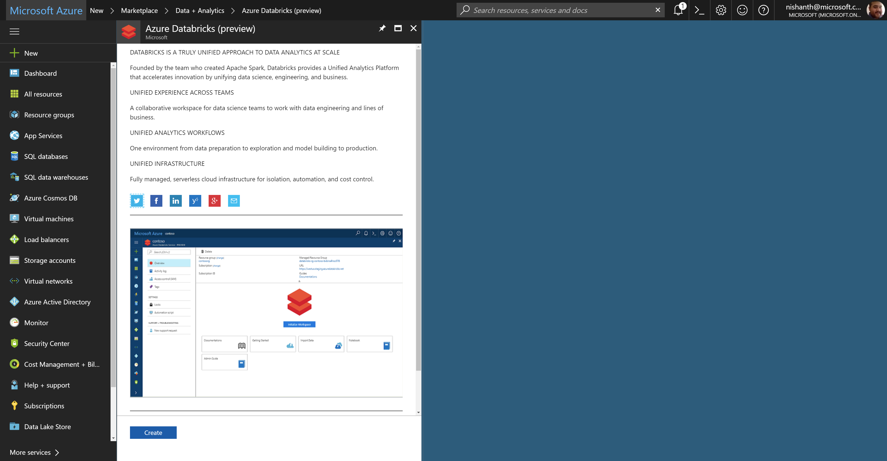
Azure Databricks – service home page

Slide 38
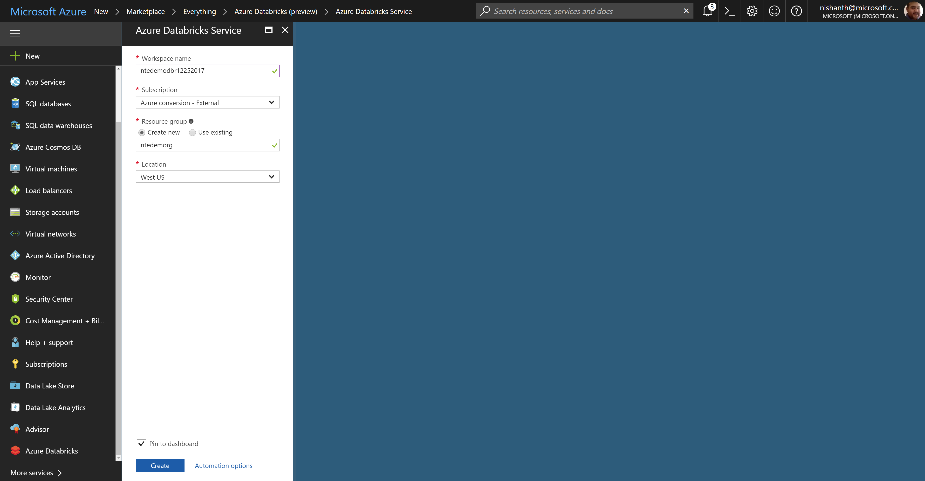
Azure Databricks – creating a workspace

Slide 39
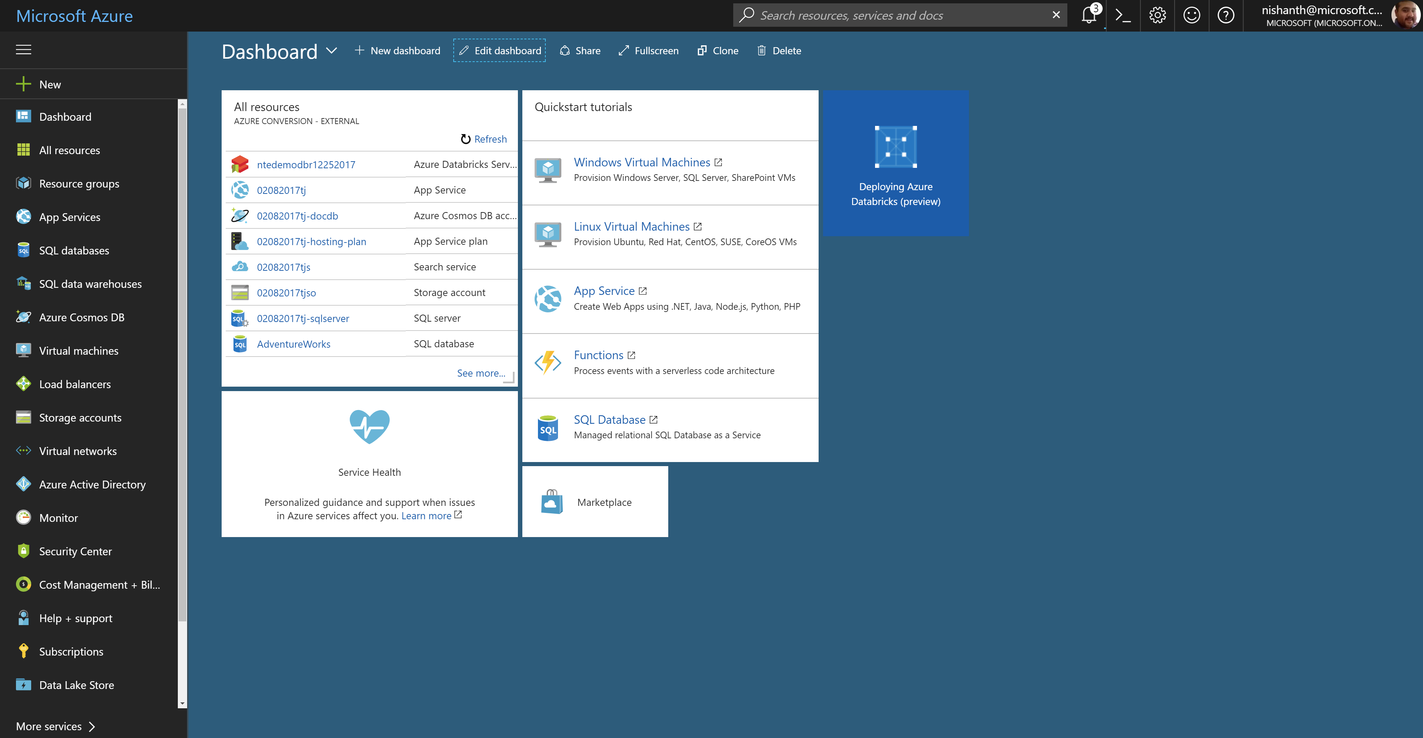
Azure Databricks – workspace deployment

Slide 40
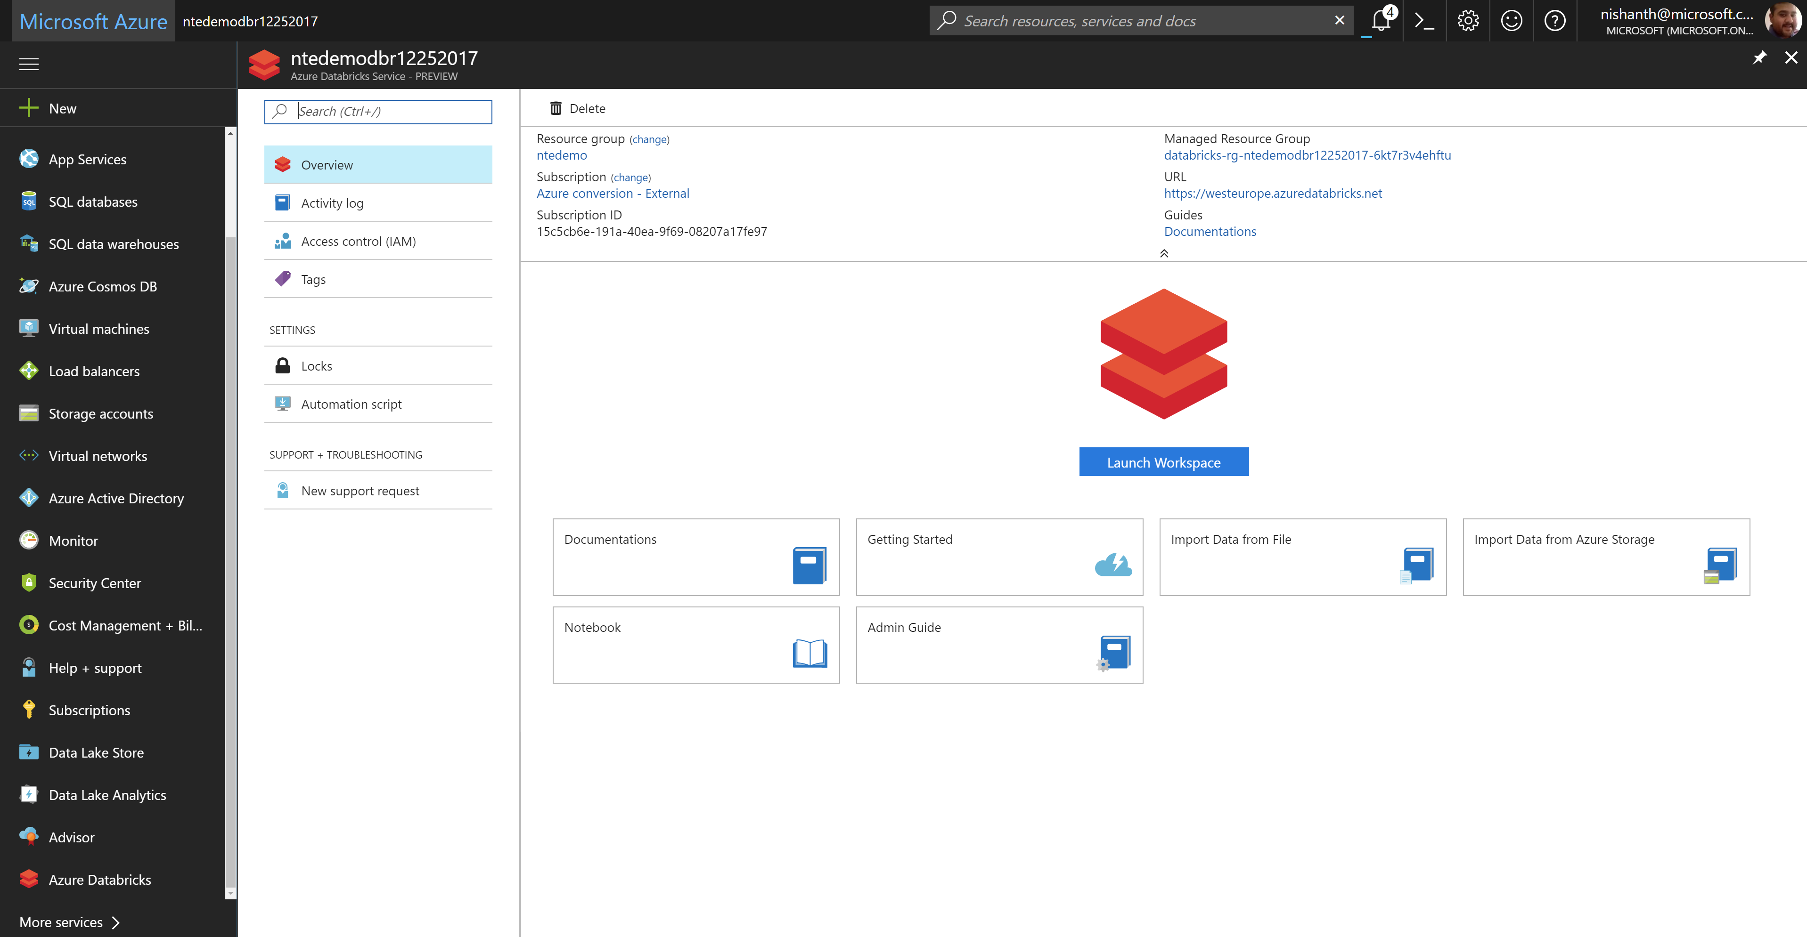
Azure Databricks – launching the workspace

Slide 41
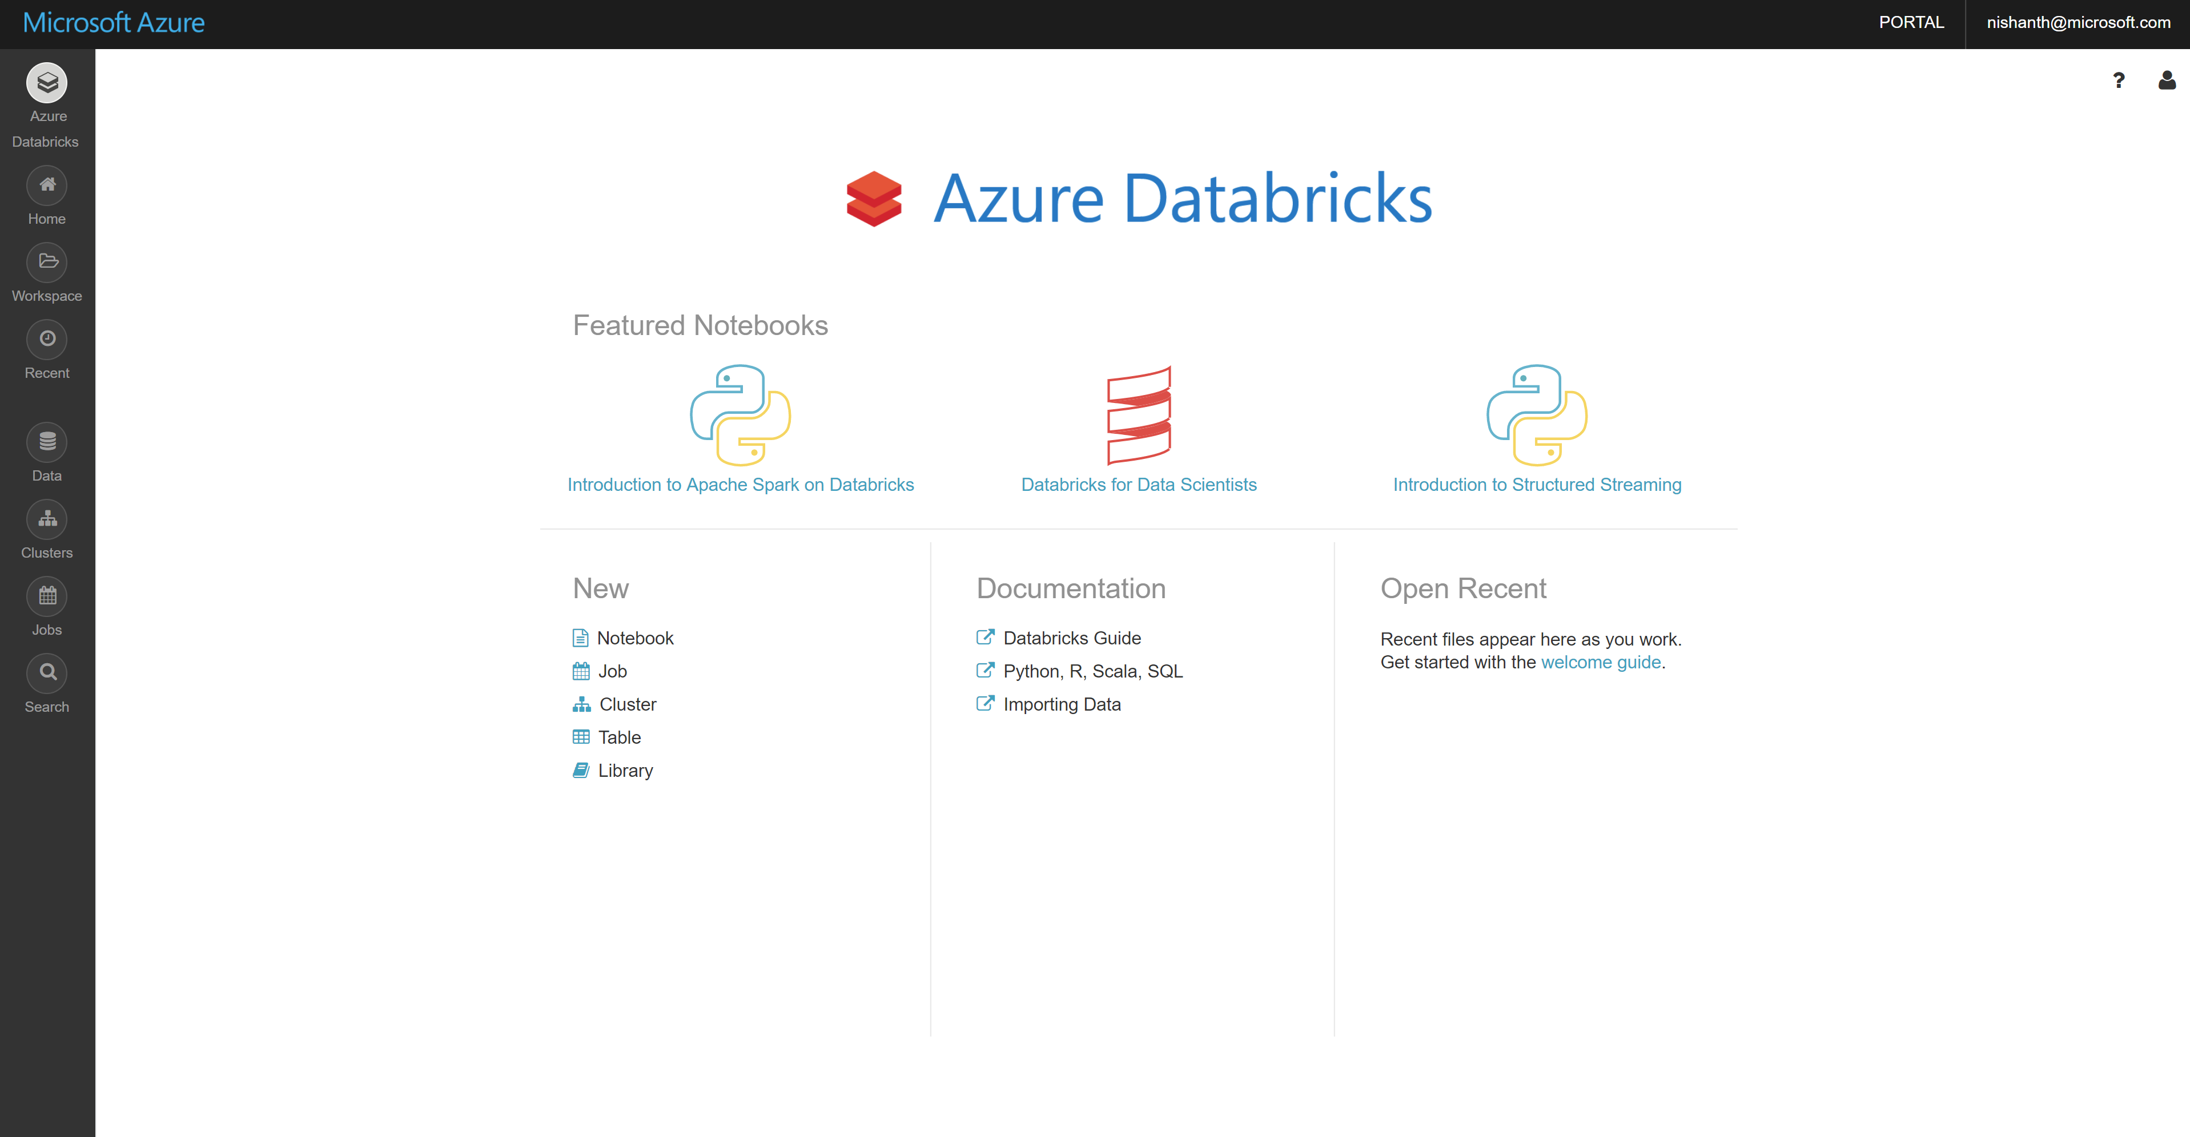
Azure Databricks – workspace home page

